Slide 1
24
7
30
Date
Index Laws Mini Lesson 3
How do you use fractional indices
Terminology
Roots
Radical sign
5
Notes:
Input

Slide 2
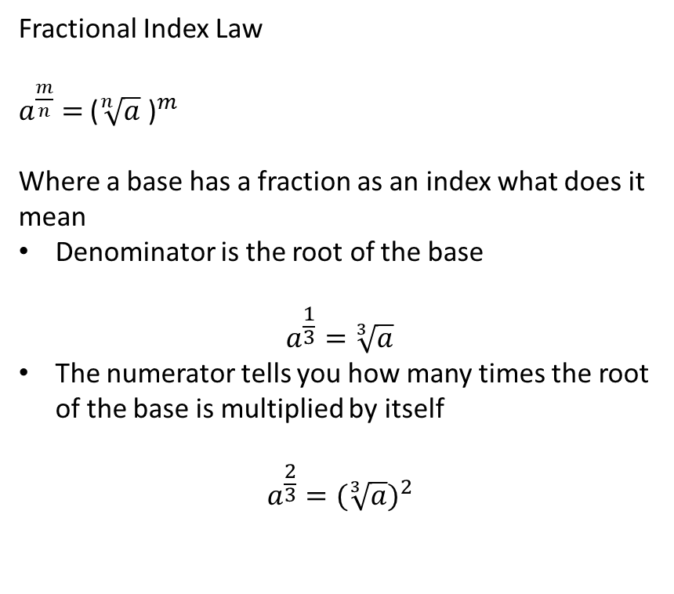
24
7
30
Date
Index Laws Mini Lesson 3
EQ – How do you use fractional indices
Fractional Index Law
$a^{\frac{m}{n}}$ $=$ ${\text{(}\sqrt[n]{a}\text{ )}}^{m}$
Where a base has a fraction as an index what does it mean
Denominator is the root of the base
$$a^{\frac{1}{3}}=\sqrt[3]{a}$$
The numerator tells you how many times the root of the base is multiplied by itself
$$a^{\frac{2}{3}}={(\sqrt[3]{a})}^{2}$$
5
Notes:
Input

Slide 3

24
7
30
Date
Index Laws Mini Lesson 3
EQ – How do you use fractional indices
Eg
$$8^{\frac{1}{3}}=\sqrt[3]{8}=2$$
$$8^{\frac{5}{3}}={(\sqrt[3]{8})}^{5}= {(2)}^{5}= 32$$
$${32}^{1.8}={32}^{\frac{9}{5}}={(\sqrt[5]{32})}^{9}= {(2)}^{9}=512$$
5
Notes:
Input

Slide 4
Activity
Nelson
Page 13
Q12 Show answers as fractional indices and using the radical sign – e, f, g, k
Q22 a, e
Q23 a, d
Notes:
Independent practice

Slide 5
Closure activity
Success Criteria
Thumbs up etc
Notes:
Closure

